Slide 1
Design and Verification of a I2C based memory subsystem
Github link:
https://github.com/mohankrishna-cv/Design-and-Verifica-on-of-a-I2C-based-memory-subsystem
Batch 1:
Divyasri Mandla
Goutham Kumar Reddy Palem
Naveen Babu Vanamala
Sai Sukitha Puli
Venkata Mohan Krishna Challa
Veera Venkata Sai Prasanna Korlapati

Slide 2
Contents
What is I2C?
Resources
Starting Point
Team’s Contribution
Operation
Design
Verification

Slide 3
What is I2C ?
I2C is a serial communication protocol, so data is transferred bit by bit along a single wire (the SDA line).
Output of bits is synchronized to the sampling of bits by a clock signal shared between the master and the slave. The clock signal is always controlled by the master.
Start Condition: The SDA line switches from a high voltage level to a low voltage level before the SCL line switches from high to low.
Stop Condition: The SDA line switches from a low voltage level to a high voltage level after the SCL line switches from low to high.
Address Frame: A 7 or 10 bit sequence unique to each slave that identifies the slave when the master wants to talk to it.
Read/Write Bit: A single bit specifying whether the master is sending data to the slave (low voltage level) or requesting data from it (high voltage level).
ACK/NACK Bit: Each frame in a message is followed by an acknowledge/no-acknowledge bit. If an address frame or data frame was successfully received, an ACK bit is returned to the sender from the receiving device.

Slide 4
Resources
https://www.nxp.com/docs/en/user-guide/UM10204.pdf - NXP
https://www.circuitbasics.com/basics-of-the-i2c-communication-protocol/ - Circuit Basics

Slide 5
Starting Point
Developed a Memory sub system model which uses the basic behaviour of the I2C.
Developing a corresponding Testbench to verify the behaviour of the all the design modules.

Slide 6
Team’s Contribution
Functional Unit
I2C Interface
Memory Controller and Memory
Top

Slide 7
Operation
The inputs are provided to the Functional unit which is a Shift Register, and it will generate the outputs
The I2C interface will collect the outputs generated by the Functional Unit, it transfers the address, wr_rdn_en and the collected outputs to the Memory Controller bit by bit through the SDA line.
Based on the address, wr_rdn_en, data the Memory controller will either write the data into the Memory or read from it.

Slide 8
Design
Four Modules
Functional Unit
I2C Interface
Memory Controller and Memory
Top

Slide 9
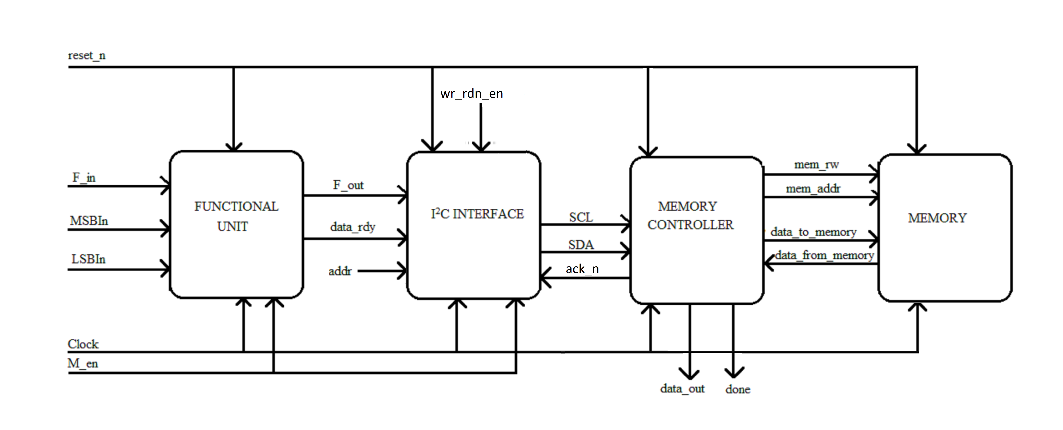
High-level representation of the circuit

Slide 10
Functional Unit
!M_en
IDLE
M_en
DISABLE
RESET
!reset_n
!reset_n
SEND
COMPUTE
OUT
LOGIC

Slide 11
I2C Interface FSM
!reset_n
RESET
!reset_n
!reset_n
STOP
!ack_n
START
SEQUENCE
!reset_n
!reset_n
!ack_n
data_ready
READ-
!ack_n
SEND
WRITE
ADDRESS

Slide 12
Memory Controller FSM
!SDA
!reset_n
STOP
!reset_n
!reset_n
RESET
SDA
WRITE
!reset_n
IDLE
SDA
r_w_in
!SDA
READ
!r_w_in
GET
ADDRESS

Slide 13
Questions?

